Slide 2
INTRODUCTION TO PROJECT
The corona virus COVID-19 pandemic is causing a global health crisis so the effective protection methods are wearing a face mask in public areas according to the World Health Organization (WHO). The COVID-19 pandemic forced government’s across the world to impose lockdowns to prevent virus transmissions. A hybrid model using deep and classical machine learning for face mask detection will be presented. A face mask detection dataset consists of with mask and without mask images , we are going to use OpenCV to do real-time face detection from a live stream via our webcam. We will use the dataset to build a COVID-19 face mask detector with computer vision using Python, OpenCV, and Tensor Flow and Keras. Our goal is to identify whether the person on image/video stream is wearing a face mask or not with the help of computer vision and deep learning.

Slide 3
To go about this python project, we’ll:
Detect faces
Classify into the person with mask and without mask
Check the accuracy of wearing mask
Put the results on the live video and display it

Slide 4
Description of the Project
To make machines more intelligent, the developers are diving into machine learning and deep learning techniques. A human learns to perform a task by practicing and repeating it again and again so that it memorizes how to perform the tasks. Then the neurons in his brain automatically trigger and they can quickly perform the task they have learned. Deep learning is also very similar to this. It uses different types of neural network architectures for different types of problems. For example – object recognition, image and sound classification, object detection, image segmentation, etc.
In this python project, we implemented a CNN to detect a person or a human being wear the mask and check the accuracy of wearing mask.

Slide 5
Hardware and Software Requirements
Sr. No. | Requirements | Type | Requirement Description
1. | Hardware Requirements | Processer | i3 or above with a Supported GPU
 |  | RAM | 8 GB RAM
 |  | Hard Disk space | 100 GB Free disk spaces
2. | Software Requirements | Operating System | Windows 10/ Windows server 2012
 |  | Prerequisite | Python (3+), Keras, Annaconda and supporting Libraries
 |  | Other | Administrator & internet access is required in the windows machine, it should be open environment.
 |  | Application access | VPN access (If required), Portal access, Application access, shared point access, SMTP port & credentials.
 |  | Browser | Google chrome, for JupyterNotebook

Slide 6
Technology and Dataset Used
Technology: Deep learning is an artificial intelligence (AI) function that imitates the workings of the human brain in processing data and creating patterns for use in decision making. Deep learning is a subset of machine learning in artificial intelligence that has networks capable of learning unsupervised from data that is unstructured or unlabelled. Also known as deep neural learning or deep neural network.
Deep learning has evolved hand-in-hand with the digital era, which has brought about an explosion of data in all forms and from every region of the world. This data, known simply as big data, is drawn from sources like social media, internet search engines, e-commerce platforms, and online cinemas, among others. This enormous amount of data is readily accessible and can be shared through fintech applications like cloud computing. However, the data, which normally is unstructured, is so vast that it could take decades for humans to comprehend it and extract relevant information.

Slide 7
Dataset
For this python project, we’ll use the Adience dataset; the dataset is available in the public domain. This dataset serves as a benchmark for face photos and is inclusive of various real-world imaging conditions like noise, lighting, pose, and appearance. The images have been collected from Flickr albums and distributed under the Creative Commons (CC) license. It has a total of 26,580 photos of 2,284 subjects in eight mask ranges (as mentioned above) and is about 1GB in size. The models we will use have been trained on this dataset.

Slide 8
Essential Libraries and Tools Used
Tools:
PyCharm: PyCharm is an integrated development environment (IDE) used in computer programming, specifically for the Python language. It is developed by the Czech company JetBrains. It provides code analysis, a graphical debugger, an integrated unit tester, integration with version
control systems (VCSes), and supports web development with Django as well as data science with Anaconda.
PyCharm is cross-platform, with Windows, macOS and Linux versions. The Community Edition is released under the Apache License, and there is also Professional Edition with extra features – released under a proprietary license.

Slide 9
Libraries
Argparse:-
The argparse module makes it easy to write user-friendly command-line interfaces. The program defines what arguments it requires, and argparse will figure out how to parse those out of sys.argv. The argparse module also automatically generates help and usage messages and issues errors when users give the program invalid arguments.

Slide 10
Libraries
Numpy:
NumPy is a Python package. It stands for 'Numerical Python'. It is a library consisting of multidimensional array objects and a collection of routines for processing of array.
Numeric, the ancestor of NumPy, was developed by Jim Hugunin. Another package Numarray was also developed, having some additional functionalities. In 2005, Travis Oliphant created NumPy package by incorporating the features of Numarray into Numeric package. There are many contributors to this open source project.
Operations using NumPy:
Using NumPy, a developer can perform the following operations −
Mathematical and logical operations on arrays.
Fourier transforms and routines for shape manipulation.
Operations related to linear algebra.
NumPy has in-built functions for linear algebra and random number generation.

Slide 11
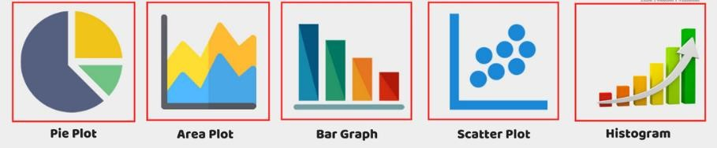
Libraries
5. Matplot: Matplot library is a python library used to create 2D graphs and plots by using python scripts. It has a module named pyplot which makes things easy for plotting by providing feature to control line styles, font properties, formatting axes etc. It supports a very wide variety of graphs and plots namely - histogram, bar charts, power spectra, error charts etc. It is used along with NumPy to provide an environment that is an effective open source alternative for MatLab. It can also be used with graphics toolkits like PyQt and wxPython.
Types of Plots:
There are various plots which can be created using python matplotlib.
Some of them are listed below:

Slide 12
Libraries
Imutils:
Before we continue to the code we need install imutils. Imutils are a series of convenience functions to make basic image processing functions such as translation, rotation, resizing, skeletonization, and displaying Matplotlib images easier with OpenCV and both Python 2.7 and Python 3.
For installing:
Open your Command Prompt and install it via:
pip install imutils

Slide 13
Libraries
6. Pandas: Pandas is an opensource Python package that is most widely used for data science/data analysis and machine learning tasks. It is built on top of another package named Numpy, which provides support for multi-dimensional arrays. As one of the most popular data wrangling packages, Pandas works well with many other data science modules inside the Python ecosystem, and is typically included in every Python distribution, from those that come with your operating system to commercial vendor distributions like Active State’s ActivePython.

Slide 14
➢ Key Features of Pandas:
Fast and efficient Data Frame object with default and customized indexing.
Tools for loading data into in-memory data objects from different file formats.
Data alignment and integrated handling of missing data.
Reshaping and pivoting of date sets.
Label-based slicing, indexing and subsetting of large data sets.
Columns from a data structure can be deleted or inserted.
Group by data for aggregation and transformations.
High performance merging and joining of data.
Time Series functionality.

Slide 15
Libraries
tensorflow/keras:
KERAS:
Like TensorFlow, Keras is an open-source, ML library that’s written in Python. The biggest difference, however, is that Keras wraps around the functionalities of other ML and DL libraries, including TensorFlow, Theano, and CNTK. Because of TF’s popularity, Keras is closely tied to that library.
Many users and data scientists, us included, like using Keras because it makes TensorFlow much easier to navigate—which means you’re far less prone to make models that offer the wrong conclusions.

Slide 16
Keras builds and trains neural networks, but it is user friendly and modular, so you can experiment more easily with deep neural networks. Keras is a great option for anything from fast prototyping to state-of-the-art research to production. The key advantages of using Keras, particularly over TensorFlow, include:
Ease of use. The simple, consistent UX in Keras is optimized for use cases, so you get clear, actionable feedback for most errors.
Modular composition. Keras models connect configurable building blocks, with few restrictions.
Highly flexible and extendable. You can write custom blocks for new research and create new layers, loss functions, metrics, and whole models.
So here, we use Keras because it offers something unique in machine learning i.e single API that works across several ML frameworks to make that work easier.

Slide 17
Working Flow of the project
1. Import the libraries and load the dataset:
First, we are going to import all the modules that we are going to need for training our model. The Keras library already contains some datasets and MNIST is one of them. So we can easily import the dataset and start working with it. The mnist.load_data() method returns us the training data, its labels and also the testing data and its labels.
2. Preprocess the data
The image data cannot be fed directly into the model so we need to perform some operations and process the data to make it ready for our neural network.
This dataset consists of 4095 images belonging to two classes:
With _mask: 2165 images
Without _mask: 1930 images

Slide 18
Working Flow of the project
3. Create the model
In the part we’ll learn about face mask detection, including the steps required to automatically predict the mask wearing by a person from an image or a video stream (and why face mask detection is best treated as a classification problem rather than a regression problem).
From there, we’ll discuss our deep learning-based mask detection model and then learn how to use the model for both:
Face mask detection in static images
Face mask detection in real-time video streams
4. Train the model
Once your face detector has produced the bounding box coordinates of the face in the image/video stream, you can move on to Stage #2 — identifying the person who were masks or who is not.

Slide 19
Working Flow of the project
5. Evaluate the model
Mask detection is the process of automatically discerning the wearing mask of a person solely from a photo of their face.
Typically, you’ll see face mask detection implemented as a two-stage process:
Stage #1: Detect faces in the input image/video stream
Stage #2: Display on the screen the person is wearing the mask or not.
6. Running real time embedded system
For Stage #1, any face detector capable of producing bounding boxes for faces in an image can be used, including but not limited to Haar cascades, HOG + Linear SVM, Single Shot Detectors (SSDs), etc.

Slide 20
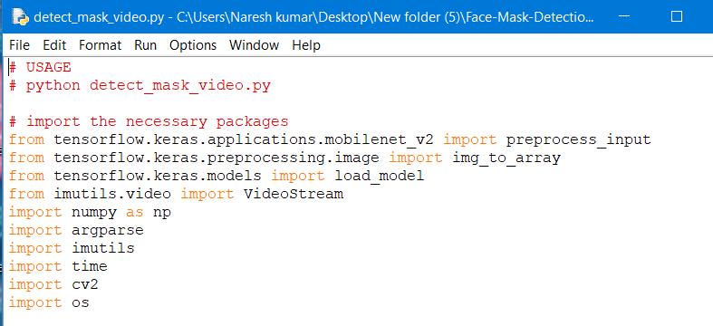
Source code
Libraries :

Slide 21
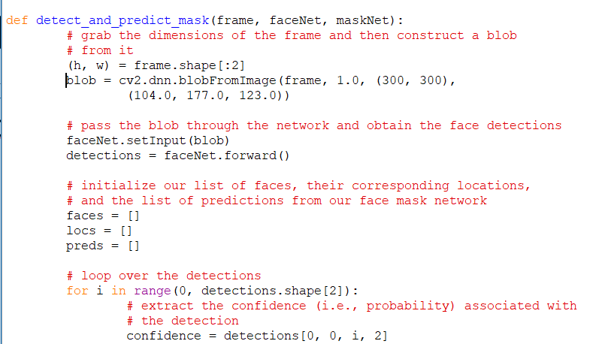
Source code
detect_and_predict_mask function:

Slide 22
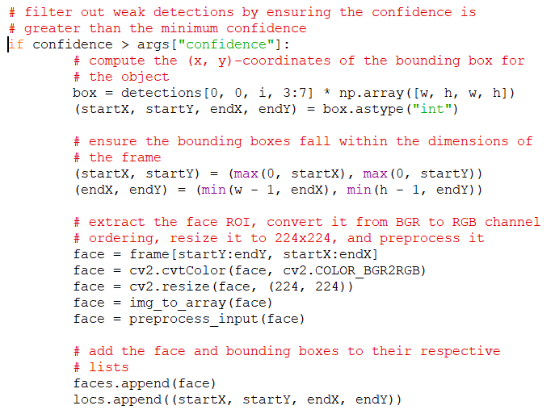
Source code

Slide 23
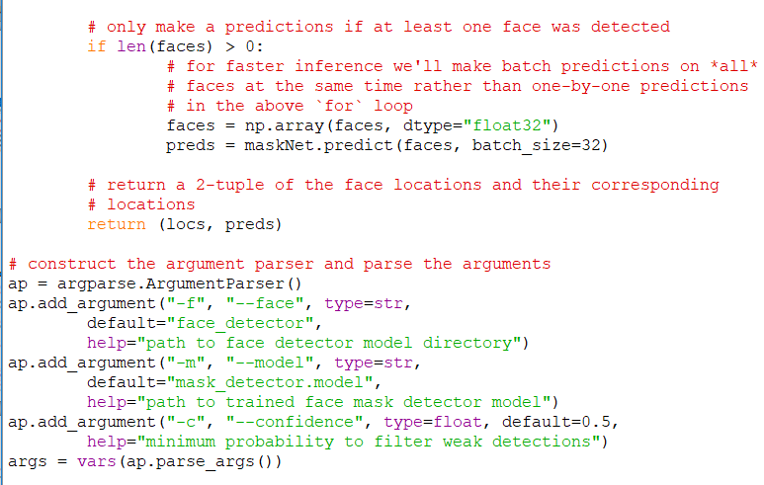
Source code

Slide 24
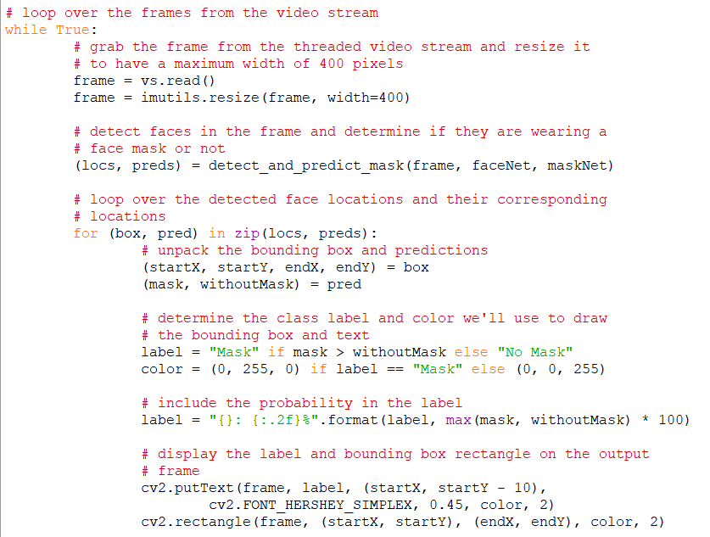
Source code

Slide 25
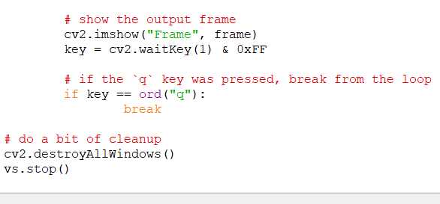
Source code

Slide 26
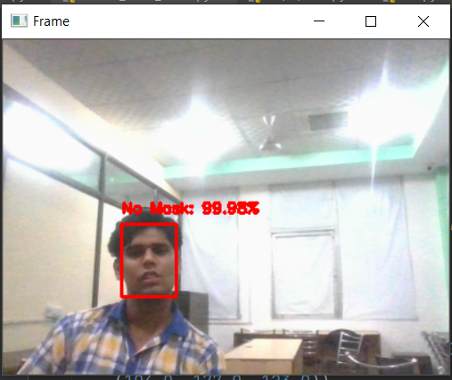
Output Screenshots:

Slide 27
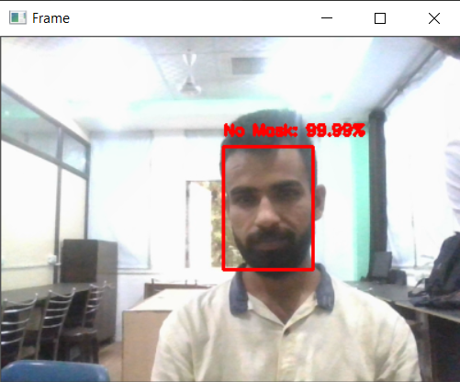
Output Screenshots:

Slide 28
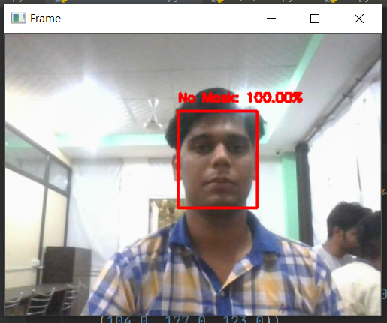
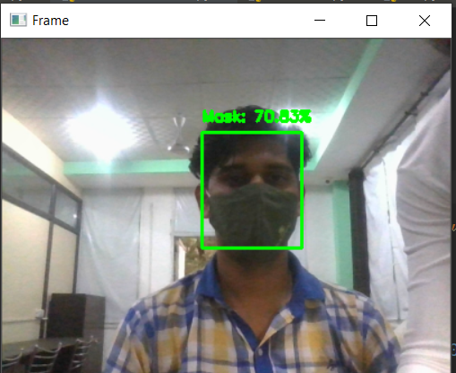
Output Screenshots:

Slide 29
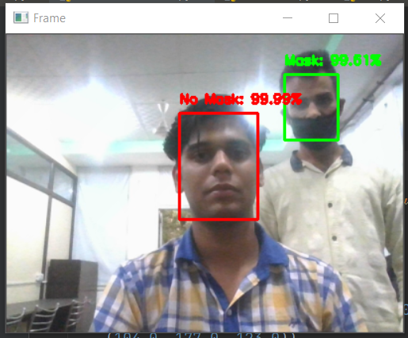
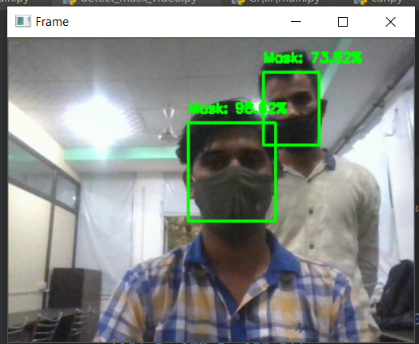

Slide 30
Conclusion
This project presents a system for a smart city to reduce the spread of coronavirus by informing the authority about the person who is not wearing a facial mask that is a precautionary measure of COVID-19. The motive of the work comes from the people disobeying the rules that are mandatory to stop the spread of coronavirus. The system contains a face mask detection architecture where a deep learning algorithm is used to detect the mask on the face. To train the model, labeled image data are used where the images were facial images with masks and without a mask. The proposed system detects a face mask with an accuracy of 98.7%. The decision of the classification network is transferred to the corresponding authority. The system proposed in this study will act as a valuable tool to strictly impose the use of a facial mask in public places for all people.

Slide 31
FUTURE SCOPE
The developed system faces difficulties in classifying faces covered by hands since it almost looks like the person wearing a mask. While any person without a face mask is traveling on any vehicle, the system cannot locate that person correctly. For a very densely populated area, distinguishing the face of each person is very difficult. For this type of scenario, identifying people without face mask would be very difficult for our proposed system. In order to get the best result out of this system, the city must have a large number of CCTV cameras to monitor the whole city as well as dedicated manpower to enforce proper laws on the violators. Since the information about the violator is sent via SMS, the system fails when there is a problem in the network.

Slide 32
FUTURE SCOPE
The proposed system mainly detects the face mask and informs the corresponding authority with the location of a person not wearing a mask. Based on this, the authority has to send their personnel to find out the person and take necessary actions. But this manual scenario can be automated by using drones and robot technology to take action instantly. Furthermore, people near to the person not wearing a mask may be alerted by an alarm signal on that location, and displaying the violators face in a LED screen to maintain a safe distance from the person would be a further study.

